Slide 1
EE227 – Digital Logic Design
Lecture 9

Slide 2
Outline
KARANUGH Map (K – Map) Method
With 2 variables
With 3 variables
With 4 variables

Slide 3
KARANUGH Map (K – Map)
K – Map is a pictorial method used to minimize Boolean expressions without having to use Boolean algebra theorems and equation manipulations
It is thought as a special version of a truth table
Using a K-map, expressions with two to four variables are easily minimized

Slide 4
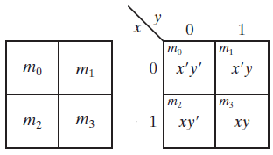
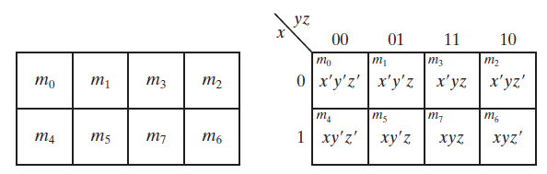
Generating K – Map (1/2)
A k map will contain 2^{n} squares
Where n is the number of variables in the expression
While generating a k-map one should keep in mind that any two adjacent squares in the map differ by only one bit
With two variables
With three variables

Slide 5
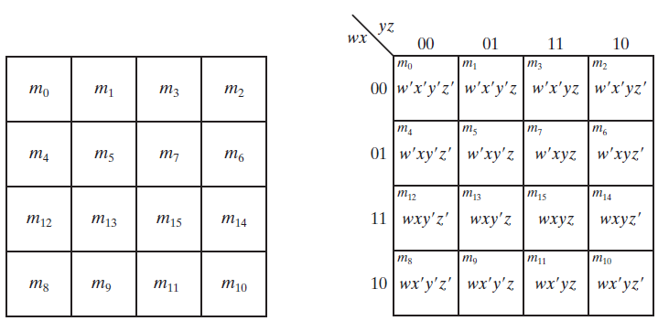
Generating K – Map (2/2)
With four variables

Slide 6
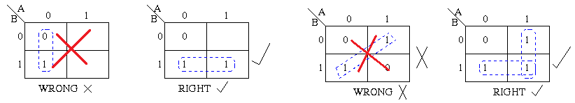
K-Map - Rules of Simplification (1/4)
While using k-map we group the 1’s present in the k-map table and note the variables which are not changing
Here are some rules for simplification and grouping of 1’s
Groups may not include any cell containing a zero
Groups may be horizontal or vertical, but not diagonal

Slide 7
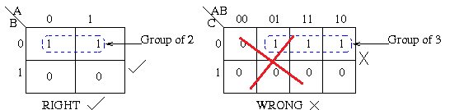
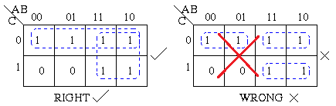
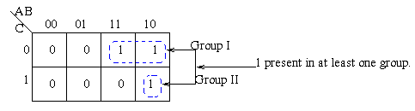
K-Map - Rules of Simplification (2/4)
Groups must contain 1, 2, 4, 8, or in general 2^{n} cells
Each group should be as large as possible
Each cell containing a one must be in at least one group

Slide 8
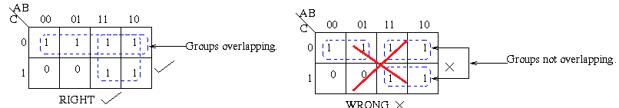
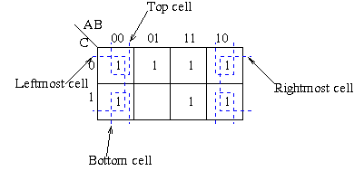
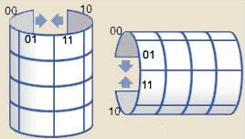
K-Map - Rules of Simplification (3/4)
Groups may overlap
Groups may wrap around the table. The leftmost cell in a row may be grouped with the rightmost cell and the top cell in a column may be grouped with the bottom cell

Slide 9
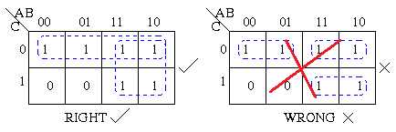
K-Map - Rules of Simplification (4/4)
There should be as few groups as possible, as long as this does not contradict any of the previous rules

Slide 10
K – Map Simplification Steps
Populate the k-map
By using truth table
Or by using minterms
Introduce all the variables in each term
Form the groups by considering the rules
Note the constant variables for each group
Multiply the constant variables of each group to form a term
Add all the terms to obtain the simplified Boolean function

Slide 11
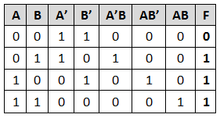
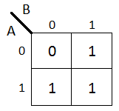
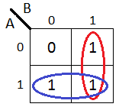
K – Map with Two Variables
Simplify the following expression by using k-map
F = A’B + AB’ + AB
The simplified expression is
F = A + B

Slide 12
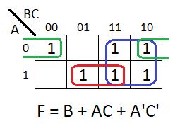
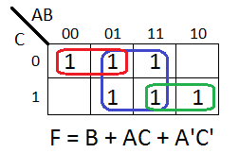
K – Map with Three Variables
Simplify the following Boolean function by using k-map
F = A’B’C’ + A’B + ABC’ + AC
F = A’B’C’ + A’B(C + C’) + ABC’ + AC(B + B’)
F = A’B’C’ + A’BC + A’BC’ + ABC’ + ABC + AB’C

Slide 13
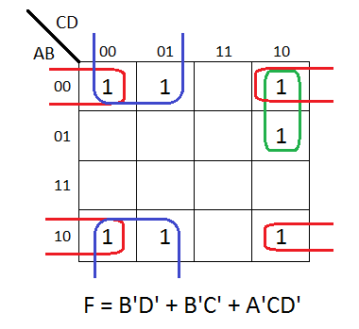
K – Map with Four Variables (1/2)
Simplify the following Boolean function by using k-map
F = A’B’C’ + B’CD + A’BCD’ + AB’C’
F = A’B’C’D + A’B’C’D’ + AB’CD + A’B’CD + A’BCD’ + AB’C’D + AB’C’D’

Slide 14
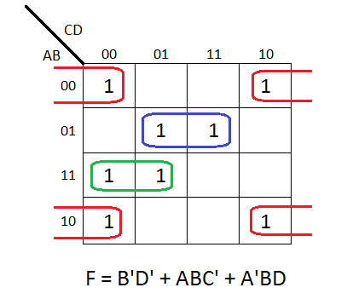
K – Map with Four Variables (2/2)
Simplify the following Boolean function by using k-map
F = A’B’C’D’ + AC’D’ + B’CD’ + A’BCD + BC’D
F = A’B’C’D + ABC’D’ + AB’C’D’ + A’B’CD’ + AB’CD’ + A’BCD + A’BC’D + ABC’D

Slide 15
Practice Problem 1
Simplify the following Boolean functions by using k-map method
F₁ = xy + x’y’z’ + x’yz’
F₂ = A’B + BC’ + BC + AB’C’
F₃ = M + MC + AC + AM + AMC
F(W,X,Y,Z) = (1, 4, 5, 6, 12, 14, 15)
Answers
F1 = x’z’ + xy
F2 = B + AC’
F3 = M + AC
F(w,x,y,z) = w’y’z + wxy + xz’

